Slide 1
TOPIC 10: File Handling

Slide 2
CONTENTS
10.1 File Input and Output
10.2 Using Loops to Process Files
10.3 Processing Records

Slide 3
Introduction to File Input and Output
When a program needs to save data for later use, it writes the data in a file. The data can be read from the file at a later time.
Word processors. Word processing programs are used to write letters, memos, reports, and other documents. The documents are then saved in files so they can be edited and printed.
Image editors. Image editing programs are used to draw graphics and edit images, such as the ones that you take with a digital camera. The images that you create or edit with an image editor are saved in files.
Spreadsheets. Spreadsheet programs are used to work with numerical data. Numbers and mathematical formulas can be inserted into the rows and columns of the spreadsheet. The spreadsheet can then be saved in a file for use later.
Games. Many computer games keep data stored in files. For example, some games keep a list of player names with their scores stored in a file.
Web browsers. Sometimes when you visit a Web page, the browser stores a small file known as a cookie on your computer. Cookies typically contain information about the browsing session, such as the contents of a shopping cart.

Slide 4
how to write data to files and read data from files
Open the file. Opening a file creates a connection between the file and the program. Opening an output file usually creates the file on the disk and allows the program to write data to it. Opening an input file allows the program to read data from the file.
Process the file. In this step, data is either written to the file (if it is an output file) or read from the file (if it is an input file).
Close the file. When the program is finished using the file, the file must be closed. Closing a file disconnects the file from the program.

Slide 5
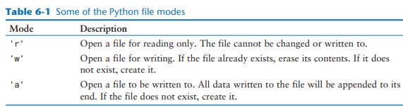
Opening a File
file_variable = open(filename, mode)
• file_variable is the name of the variable that will reference the file object.
• filename is a string specifying the name of the file.
• mode is a string specifying the mode (reading, writing, etc.) in which the file will be
opened.
customer_file = open('customers.txt', 'r')

Slide 6
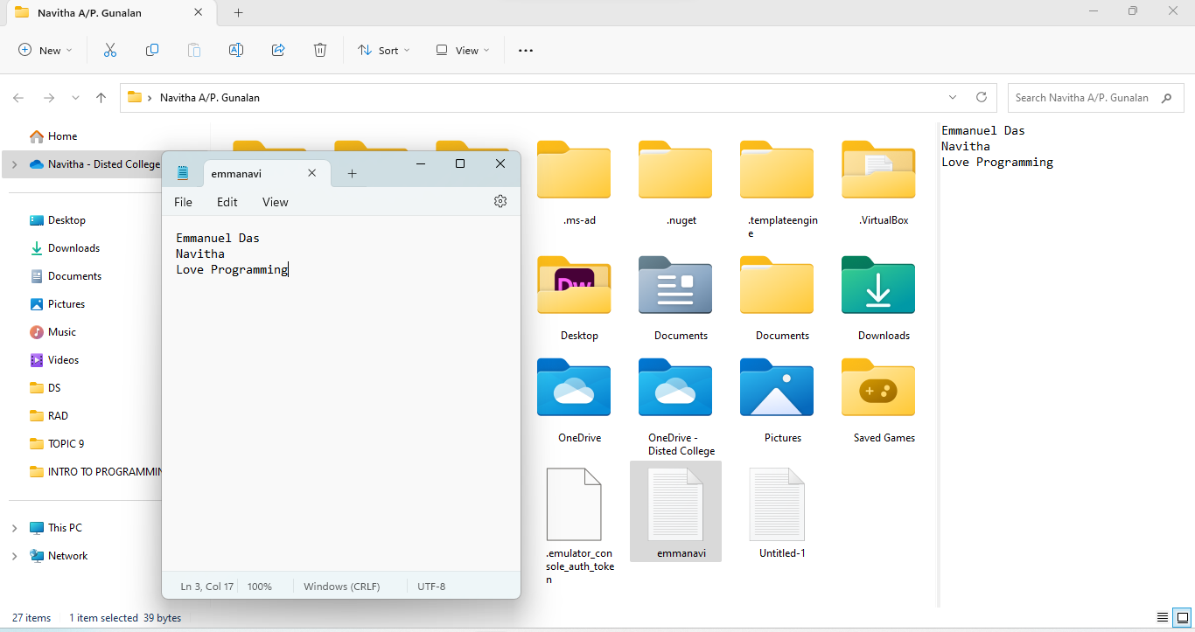

# This program writes three lines of data
# to a file.
def main():
# Open a file named emmanavi.txt.
outfile = open('emmanavi.txt', 'w')
# Write the names of three
# to the file.
outfile.write('Emmanuel Das\n')
outfile.write('Navitha\n')
outfile.write('Love Programming\n')
# Close the file.
outfile.close()
# Call the main function.
if __name__ == '__main__':
main()
# This program reads and displays the contents
# of the emmanavi.txt file.
def main():
# Open a file named emmanavi.txt.
infile = open('emmanavi.txt', 'r')
# Read the file's contents.
file_contents = infile.read()
# Close the file.
infile.close()
# Print the data that was read into memory.
print(file_contents)
# Call the main function.
if __name__ == '__main__':
main()

Slide 7
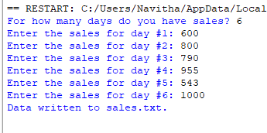
Using Loops to Process Files
# This program prompts the user for sales amounts
# and writes those amounts to the sales.txt file.
def main():
# Get the number of days.
num_days = int(input('For how many days do you have sales? '))
# Open a new file named sales.txt.
sales_file = open('sales.txt', 'w')
# Get the amount of sales for each day and write
# it to the file.
for count in range(1, num_days + 1):
# Get the sales for a day.
sales = float(input(f'Enter the sales for day #{count}: '))
# Write the sales amount to the file.
sales_file.write(f'{sales}\n')
# Close the file.
sales_file.close()
print('Data written to sales.txt.')
# Call the main function.
if __name__ == '__main__':
main()
Files usually hold large amounts of data, and programs typically use a loop to process the data in a file.

Slide 8
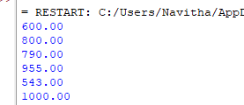
# This program reads all of the values in the sales.txt file.
def main():
# Open the sales.txt file for reading.
sales_file = open('sales.txt', 'r')
# Read the first line from the file, but
# don't convert to a number yet. We still
# need to test for an empty string.
line = sales_file.readline()
# As long as an empty string is not returned
# from readline, continue processing.
while line != '':
# Convert line to a float.
amount = float(line)
# Format and display the amount.
print(f'{amount:.2f}')
# Read the next line.
line = sales_file.readline()
# Close the file.
sales_file.close()
# Call the main function.
if __name__ == '__main__':
main()

Slide 9
question
Kevin is a freelance video producer who makes TV commercials for local businesses. When he makes a commercial, he usually films several short videos. Later, he puts these short videos together to make the final commercial. He has asked you to write the following two programs.
A program that allows him to enter the running time (in seconds) of each short video in a project. The running times are saved to a file.
A program that reads the contents of the file, displays the running times, and then displays the total running time of all the segments.
Get the number of videos in the project.
Open an output file.
For each video in the project:
Get the video's running time.
Write the running time to the file.
Close the file.

Slide 10
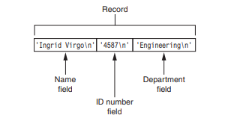
Processing Records
The data that is stored in a file is frequently organized in records. A record is a complete set of data about an item, and a field is an individual piece of data within a record.

Slide 11
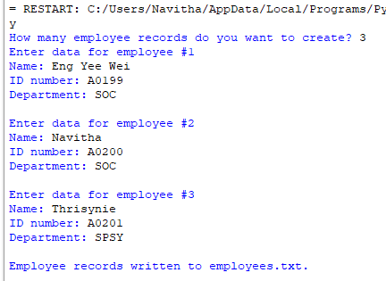
def main():
# Get the number of employee records to create.
num_emps = int(input('How many employee records do you want to create? '))
# Open a file for writing.
emp_file = open('employees.txt', 'w')
# Get each employee's data and write it to the file.
for count in range(1, num_emps + 1):
# Get the data for an employee.
print(f'Enter data for employee #{count}')
name = input('Name: ')
id_num = input('ID number: ')
dept = input('Department: ')
# Write the data as a record to the file.
emp_file.write(f'{name}\n')
emp_file.write(f'{id_num}\n')
emp_file.write(f'{dept}\n')
# Display a blank line.
print()
# Close the file.
emp_file.close()
print('Employee records written to employees.txt.')
if __name__ == '__main__':
main()

Slide 12
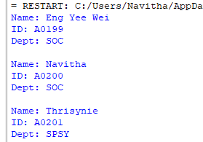
def main():
# Open the employees.txt file.
emp_file = open('employees.txt', 'r')
# Read the first line from the file, which is
# the name field of the first record.
name = emp_file.readline().rstrip('\n')
# Loop to process and display records.
while name:
# Read the ID number field.
id_num = emp_file.readline().rstrip('\n')
# Read the department field.
dept = emp_file.readline().rstrip('\n')
# Display the record.
print(f'Name: {name}')
print(f'ID: {id_num}')
print(f'Dept: {dept}')
print()
# Read the name field of the next record.
name = emp_file.readline().rstrip('\n')
# Close the file.
emp_file.close()
if __name__ == '__main__':
main()

Slide 13
QUESTION
Midnight Coffee Roasters, Inc. is a small company that imports raw coffee beans from around the world and roasts them to create a variety of gourmet coffees. Julie, the owner of the company, has asked you to write a series of programs that she can use to manage her inventory. After speaking with her, you have determined that a file is needed to keep inventory records. Each record should have two fields to hold the following data:
• Description. A string containing the name of the coffee
• Quantity in inventory. The number of pounds in inventory, as a floating-point number Your first job is to write a program that can be used to add records to the file.

